Slide 1
Path forward: Getting to zero carbon equitably
Srinidhi Sampath Kumar
Sustainable Housing Policy and Program Manager
ssampath@chpc.net
May 22nd, 2020

Slide 2
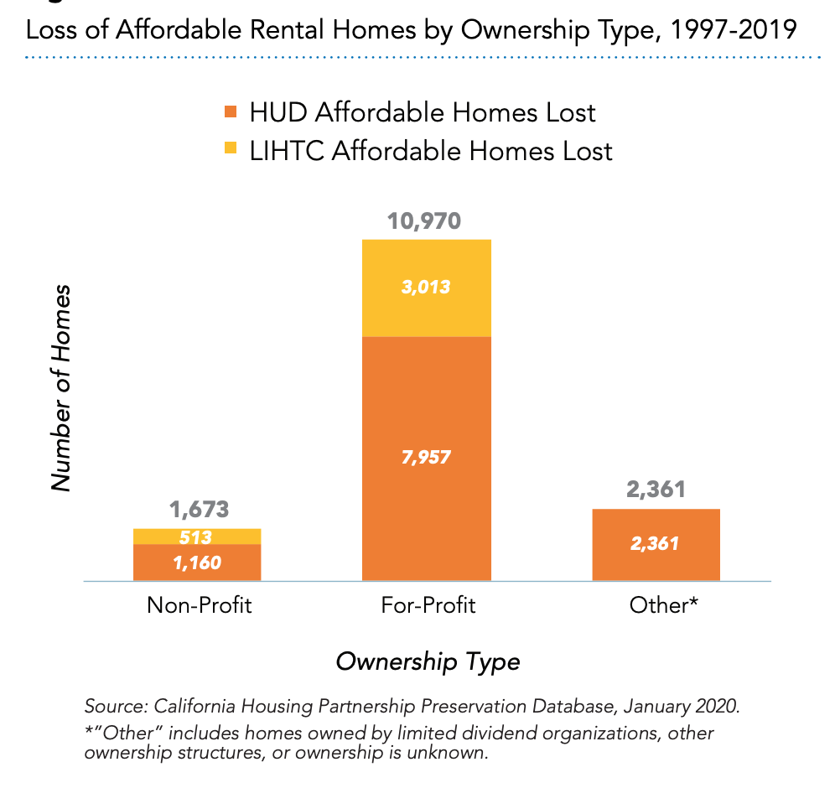
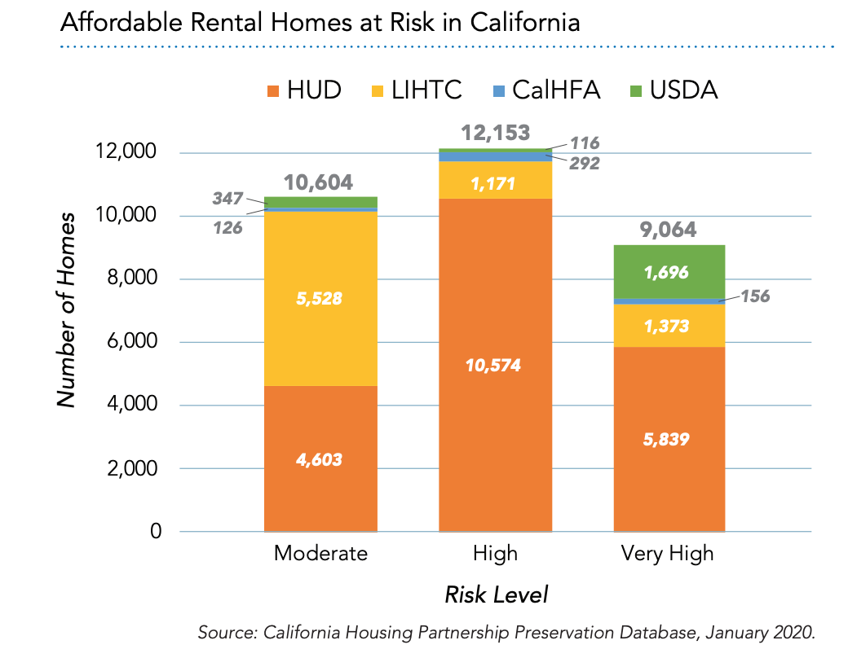
Housing Financing Landscape and Other Costs Considerations
Notes:
31,821 affordable rental homes are at risk of converting to market rate in the next ten years. • Of these, 9,064 homes (28 percent) are at risk of converting to market rate in the next year. Again, these were pre-COVID data. With 25% rent loss over a year, we can lose up to 2000 AH properties.
These are properties that are subject to a lot of regulations and have limited funds.
AH is declining stock. Lot of pressure on developers to manage their costs
There is a need for owners to have the resources to pay for the decarb measures. Not put these existing buildings further at risk.
BD policies should not make it difficult for AH developers to preserve AH
It should be done in a way that empowers AH developers to do it through policies, streamlines programs
BD could be a strategy for preserving AH and there is a lot of opportunity here with a lot of thoughtful policy consideration

Slide 3
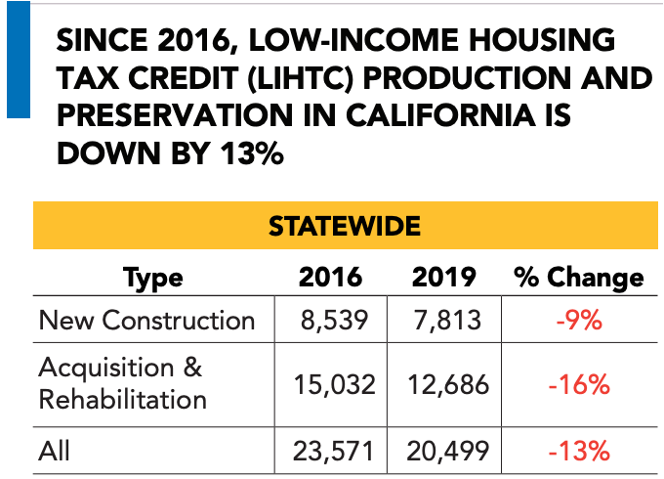
Housing Financing Landscape and Other Costs Considerations
Federal and State housing funds drying up
Construction costs
Operating expenses + replacement reserve
Source: California Housing Partnership’s:2020 California Affordable Housing Needs Report
Notes:
State tax credits go quick- only about 40 properties gets constructed every year- so production is already low
HCED funds are drying up in 3-4 years including No Place Like Home and Veterans Homeless Housing Program
TCAC High costs tests for new and existing buildings
Owners are looking for opportunities to reduce their operating expenses
Wherever possible, one can use replacement reserve but not all developers have it
There are other rehab projects that are not going through LIHTC
Terner Center report

Slide 4
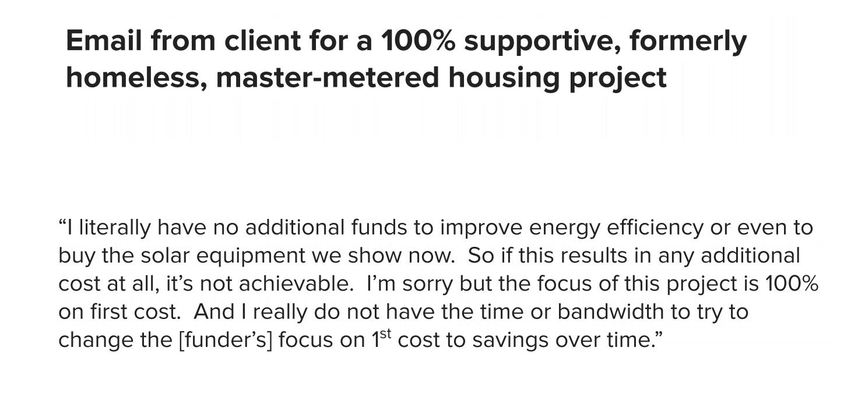
From an affordable housing developer to an architect
Notes:
This is focused on new construction but this largely sums up most of the challenges I will be presenting about and the recommendations that I put forth.

Slide 5
Challenges
Developer Size and Experience
Property type
Portfolio region and disparate local reach codes
Maintenance staff and vendors
Contractor availability and experience
Disconnect between designers, engineers and changing policies
Availability of equipment that have a track record
Notes:
Dev size influences have more staff capacity, a dedicated sustainability staff, more likely to have sustainability initiatives
Keeping up with the pace of change- staff capacity and organizational financial stability
Few maintenance vendors
Construction schedule and sticking with the timeline
Working out the kinks in operation
Sizing including for ev, storage can be underestimated

Slide 6
Other Challenges
Equipment challenges: central domestic hot water and laundry systems
Resilience during shut offs and storage issues
System Sizing issues
Costs of infrastructure upgrades and transformer sizing
Notes:
Keeping up with the pace of change- staff capacity and organizational financial stability
Few maintenance vendors
Construction schedule and sticking with the timeline
Working out the kinks in operation
Sizing including for ev, storage can be underestimated

Slide 7
Recommendations
Update T24 to remove any electrification barriers
Remove silos between housing and energy programs
More reliable and stable funding for programs that work
Pilot building decarbonization in different regions and track costs gaps
State-wide cost impacts study on both new and existing affordable housing to inform incentive programs
Notes:
No property owner who is working on a new construction wants to willingly put in gas. They all see the importance of removing gas from buildings.
But this needs to be done with more input directly received from property managers, and from asset managers and staff who work in the property
so property owners with portfolio across different cities can manage more easily
LIWP program has a waitlist of 18,000 households living in DACs

Slide 8
Recommendations
Education:
Guidance document for property managers on how to be decarb ready
Resident training and user experience
Contractor training and approved contractors list
Training code enforcement officials
Lender training on costs to savings over time
Keep focus on core goals of providing affordable housing
Notes:
No property owner who is working on a new construction wants to willingly put in gas. They all see the importance of removing gas from buildings.
But this needs to be done with more input directly received from property managers, and from asset managers and staff who work in the property
so property owners with portfolio across different cities can manage more easily

